Slide 1

Infographics & Documentation
The Professional Standard for Digital Reporting

Slide 2






MODULE OUTCOMES
Simplify
Standardize
Integrate
Learn to condense complex data into scannable, visual infographic stories.
Master the 5-Chapter framework for academic and industry project reports.
Seamlessly blend visuals with technical documentation for maximum clarity.

Slide 3

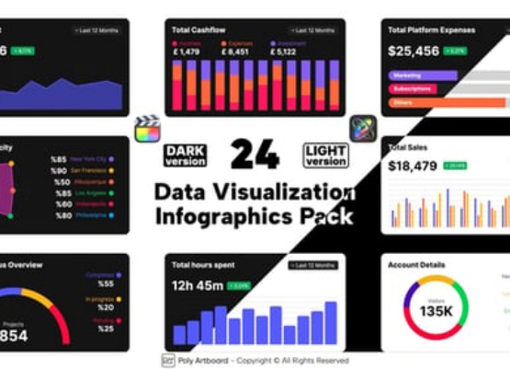
VISUAL STORYTELLING
Beyond Mere Decoration
Infographics are cognitive bridges. They turn raw, overwhelming data into actionable knowledge in seconds.
High Recall Rates
Rapid Information Processing
Viral Engagement Potential

Slide 4
The 5-Chapter Framework
The backbone of professional project documentation.

Slide 5


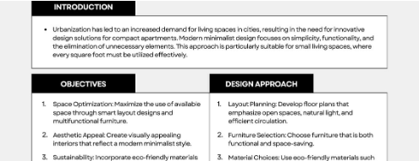
CHAPTER 1: INTRODUCTION
Setting the Scene
Identify the burning problem and define why your project matters.
Problem Background
Project Objectives (SLOs)

Slide 6
CHAPTER 2: REVIEW
Contextual Analysis: Researching how others have solved similar problems in your discipline.
Theoretical Foundation: Defining the core concepts and design standards that guide your project.
Gap Identification: Spotting what is missing in current solutions to justify your unique approach.

Slide 7



CHAPTER 3: METHODOLOGY
The "How" of your project—mapping out the logic, tools, and sequence of creation.
1. Research
2. Wireframe
3. Tools
4. Review
Data Gathering
Structural Logic
Canva & Assets
Critical Feedback

Slide 8
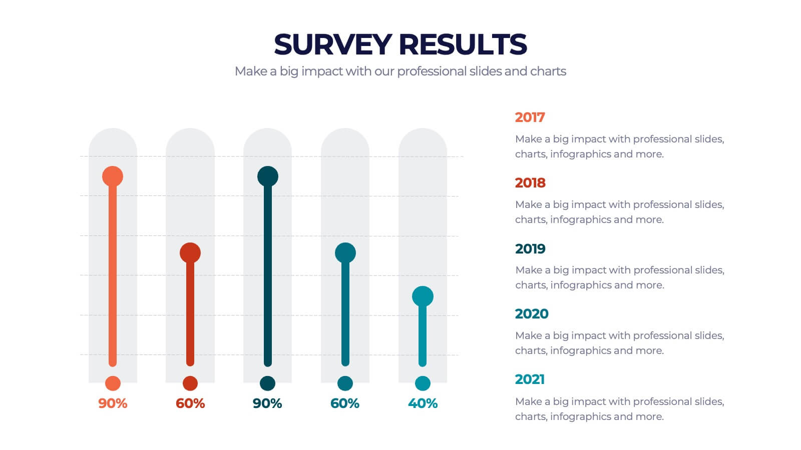
CHAPTER 4: EXECUTION
The Proof of Concept
Showcasing your final design or solution. This chapter is visual-heavy, using charts and screenshots to prove your results.
Document the testing phase: What worked? What needed refinement based on user data?

Slide 9
CHAPTER 5: EVALUATION
Final
Closing the Narrative
Summarize your achievements relative to Chapter 1's objectives. Provide a roadmap for future work or project scalability.
The Verdict

Slide 10

VISUAL INTEGRATION
Integration Strategy
Never treat infographics as appendices. Embed them directly into the textual context to reduce reader cognitive load.
PDF Accessibility
GitHub Markdown Embedding

Slide 11
EVALUATION RUBRIC
Criteria | Exceptional (100) | Developing (75)
Visual Clarity | Infographic simplifies data with zero clutter. | Visual is decorative rather than informative.
Structure | Logic flows seamlessly through all 5 chapters. | Sections feel disconnected or repetitive.
Integration | Visuals are perfectly context-embedded. | Images are placed at the end only.

Slide 12

Questions?

